Slide 1
Memory Test
Memory organization
Memory test complexity
Faults and fault models
MATS+ march test
Address Decoder faults
Summary
References

Slide 2

RAM Organization

Slide 3
Test Time in Seconds
(Memory Cycle Time 60ns)
Size Number of Test Algorithm Operations
n bits
1 Mb
4 Mb
16 Mb
64 Mb
256 Mb
1 Gb
2 Gb
n
0.06
0.25
1.01
4.03
16.11
64.43
128.9
n × log₂n
1.26
5.54
24.16
104.7
451.0
1932.8
3994.4
n^{3/2}
64.5
515.4
1.2 hr
9.2 hr
73.3 hr
586.4 hr
1658.6 hr
n²
18.3 hr
293.2 hr
4691.3 hr
75060.0 hr
1200959.9 hr
19215358.4 hr
76861433.7 hr

Slide 4

SRAM Fault Modeling Examples
SA0
AF+SAF
SAF
SCF
<0;0>
SA0
TF
<↓/0>
TF
<↑/1>
SCF
<1;1>
SA0

Slide 5

DRAM Fault Modeling
SA1
SA1+SCF
AND
Bridging
Fault (ABF)
ABF
SA0
SCF
ABF

Slide 6
SRAM Only Fault Models
Faults found only in SRAM
Open-circuited pull-up device
Excessive bit line coupling capacitance
Model
DRF
CF

Slide 7
DRAM Only Fault Models
Faults only in DRAM
Data retention fault (sleeping sickness)
Refresh line stuck-at fault
Bit-line voltage imbalance fault
Coupling between word and bit line
Single-ended bit-line voltage shift
Precharge and decoder clock overlap
Model
DRF
SAF
PSF
CF
PSF
AF

Slide 8
Reduced Functional Faults
Fault
Stuck-at fault
Transition fault
Coupling fault
Neighborhood Pattern Sensitive fault*
SAF
TF
CF
NPSF
* M. L. Bushnell and V. D. Agrawal, Essentials of Electronic Testing
for Digital, Memory and Mixed-Signal VLSI Circuits, Springer, 2000,
Chapter 9.

Slide 9

Stuck-at Faults
Test Condition: For each cell, read a 0 and a 1.
< /0> (< /1>)
A
A

Slide 10

Transition Faults
Cell fails to make a 0 → 1 or 1 → 0 transition.
Test Condition: Each cell must have an ↑ transition and a ↓ transition, and be read each time before making any further transitions.
<↑/0>, <↓/1>
<↑/0> transition fault

Slide 11
Coupling Faults
Coupling Fault (CF): Transition in bit j (aggressor) causes unwanted change in bit i (victim)
2-Coupling Fault: Involves 2 cells, special case of k-Coupling Fault
  Must restrict k cells for practicality
Inversion (CFin) and Idempotent (CFid) Coupling Faults -- special cases of 2-Coupling Faults
Bridging and State Coupling Faults involve any # of cells
Dynamic Coupling Fault (CFdyn) -- Read or write on j forces i to 0 or 1

Slide 12

State Transition Diagram of Two Good Cells, i and j

Slide 13

State Transition Diagram for CFin < ↑ ; ↕ >

Slide 14

State Coupling Faults (SCF)
Aggressor cell or line j is in a given state y and that forces victim cell or line i into state x
< 0;0 >, < 0;1 >, < 1;0 >, < 1;1 >

Slide 15
March Test Elements
M0: { March element (w0) }
  for cell := 0 to n - 1 (or any other order) do
    write 0 to A [cell];
M1: { March element (r0, w1) }
  for cell := 0 to n - 1 do
    read A [cell]; { Expected value = 0}
    write 1 to A [cell];
M2: { March element (r1, w0) }
  for cell := n – 1 down to 0 do
    read A [cell]; { Expected value = 1 }
    write 0 to A [cell];

Slide 16
March Tests
Algorithm
MATS
MATS+
MATS++
MARCH X
MARCH C-
MARCH A
MARCH Y
MARCH B
Description
{ (w0); (r0, w1); (r1) }
{ (w0); (r0, w1); (r1, w0) }
{ (w0); (r0, w1); (r1, w0, r0) }
{ (w0); (r0, w1); (r1, w0); (r0) }
{ (w0); (r0, w1); (r1, w0);
(r0, w1); (r1, w0); (r0) }
{ (w0); (r0, w1, w0, w1); (r1, w0, w1);
(r1, w0, w1, w0); (r0, w1, w0) }
{ (w0); (r0, w1, r1); (r1, w0, r0); (r0) }
{ (w0); (r0, w1, r1, w0, r0, w1);
(r1, w0, w1); (r1, w0, w1, w0);
(r0, w1, w0) }

Slide 17

Address Decoder Faults (ADFs)
Address decoding error assumptions:
  Decoder does not become sequential
  Same behavior during both read and write
Multiple ADFs must be tested for
Decoders can have CMOS stuck-open faults

Slide 18
Theorem
A March test satisfying conditions 1 & 2 detects all address decoder faults.
... Means any # of read or write operations
Before condition 1, must have wx element
  x can be 0 or 1, but must be consistent in test
Condition
1
2
March element
(rx, …, w x )
(r x , …, wx)

Slide 19
March Test Fault Coverage
Algorithm
MATS
MATS+
MATS++
MARCH X
MARCH C-
MARCH A
MARCH Y
MARCH B
SAF
All
All
All
All
All
All
All
All
ADF
Some
All
All
All
All
All
All
All
TF
All
All
All
All
All
All
CF
in
All
All
All
All
All
CF
id
All
CF
dyn
All
SCF
All

Slide 20
March Test Complexity
Algorithm
MATS
MATS+
MATS++
MARCH X
MARCH C-
MARCH A
MARCH Y
MARCH B
Complexity
4n
5n
6n
6n
10n
15n
8n
17n

Slide 21

MATS+ Example
Cell (2,1) SA0 Fault
MATS+: { M0: (w0); M1: (r0, w1); M2: (r1, w0) }

Slide 22

MATS+ Example
Cell (2, 1) SA1 Fault
MATS+: { M0: (w0); M1: (r0, w1); M2: (r1, w0) }

Slide 23

MATS+ Example
Multiple AF: Addressed Cell Not Accessed; Data Written to Wrong Cell
Cell (2,1) is not addressable
Address (2,1) maps onto (3,1), and vice versa
Cannot write (2,1), read (2,1) gives random data
MATS+: { M0: (w0); M1: (r0, w1); M2: (r1), w0 }

Slide 24
Memory Test Summary
Multiple fault models are essential
Combination of tests is essential:
  March test – SRAM and DRAM
Other tests
  NPSF – DRAM
  DC parametric – SRAM and DRAM
  AC parametric – SRAM and DRAM

Slide 25
Memory NPSF and Parametric Test
Definitions of NPSFs
NPSF test algorithms
Parametric tests
Summary
References

Slide 26
Neighborhood Pattern Sensitive Faults
Definitions:
  Neighborhood – Immediate cluster of k cells whose operation makes a base cell fail
  Base cell – A cell under test
  Deleted neighborhood – A neighborhood without the base cell
ANPSF – Active NPSF
APNPSF – Active and Passive NPSF
PNPSF – Passive NPSF
SNPSF -- Static NPSF
Assumption: Read operations are fault-free

Slide 27
Type-1 Active NPSF
Active: Base cell changes when any one deleted neighborhood cell has a transition
Condition for detection & location: Each base cell must be read in state 0 and state 1, for all possible deleted neighborhood pattern changes.
C _{i,j} <d₀, d₁, d₃, d₄ ; b>
C _{i,j} <0, ↓ , 1, 1; 0> and C _{i,j} <0, ↓ , 1, 1; ↕ >
2
2 – base cell
0, 1, 3 and 4 – deleted neighborhood
cells
0
1
3
4

Slide 28
Type-2 Active NPSF
Used when diagonal couplings are significant, and do not necessarily cause horizontal/vertical coupling
4 – base cell
0, 1, 2, 3, 5, 6, 7 and 8 – deleted
neighborhood cells
4
0
1
2
3
5
6
7
8

Slide 29
Passive NPSF
Passive: A certain neighborhood pattern prevents the base cell from changing
Condition for detection and location: Each base cell must be written and read in state 0 and in state 1, for all deleted neighborhood pattern changes.
↑ / 0 ( ↓ /1) – Base cell fault effect indicating that base cannot change

Slide 30
Static NPSF
Static: Base cell forced into a particular state when deleted neighborhood contains particular pattern.
Differs from active – need not have a transition to sensitize SNPSF
Condition for detection and location: Apply all 0 and 1 combinations to k-cell neighborhood, and verify that each base cell was written.
C_{i,j} < 0, 1, 0, 1; - / 0> and C_{i,j} < 0, 1, 0, 1; - / 1>

Slide 31
NPSF Fault Detection and Location Algorithm
write base-cells with 0;
loop
    apply a pattern; { it could change the base-cell from 0 to 1. }
    read base-cell;
  endloop;
write base-cells with 1;
loop
    apply a pattern; { it could change the base-cell from 1 to 0. }
    read base-cell;
  endloop;

Slide 32
Number of Neighborhood Patterns
Active Neighborhood Patterns (ANP)
  Base cell 0 and 1
    ↑ and ↓ transitions in k-1 cells
      All 0-1 patterns in k-2 cells
  2(k-1) 2×2^{k-2} = (k-1) 2^{k} patterns
Passive Neighborhood Patterns (PNP)
  Base cell ↑ and ↓ transition
    All 0-1 patterns in k-1 cells
  2×2^{k-1} = 2^{k} patterns
Total APNP patterns = (k-1) 2^{k} + 2^{k} = k 2^{k}
Static Neighborhood Patterns (SNP) = 2^{k}

Slide 33
Hamiltonian Path, k = 5
1110
1111
Hamiltonian path for SNPSF
Deleted
neighborhood
patterns
1010
1011
0110
0111
1100
1101
end
0010
0011
1000
1001
0100
0101
0000
0001
Eulerian path for ANPSF
start

Slide 34
Fault Coverage Hierarchy
APNPSF
SNPSF
ANPSF
PNPSF
TF
SAF

Slide 35
Parametric (Electrical) Testing
Test for:
  Major voltage / current / delay deviation from part data book value
  Unacceptable operation limits
  Divided bit-line voltage imbalance in RAM
  RAM sleeping sickness – broken capacitor, leaks – shortens refresh interval

Slide 36
DC Parametric Tests
Production test – done during burn-in
  Applied to all chips
  Chips experience high temperature + over-voltage power supply
  Catches initial, early lifetime component failures – avoid selling chips that fail soon

Slide 37
Test Output Leakage Current
1.
2.
3.
4.
5.
6.
7.
1.
2.
3.
Apply high to chip select, deselect chip
Set chip pins to be in tri-state mode
Force high on each data-out line – measure I_{OZ}
Force low on each data-out line – measure I_{OZ}
Select chip (low on chip select)
Set read, force high on each address/data line,
measure I_{I}
Set read, force low on each address/data line,
measure I_{I}
Possible Test Outcomes:
I_{OZ} < 10 mA and I_{I} < 10 mA (passes)
I_{OZ} ≥ 10 mA (fails)
I_{I} ≥ 10 mA (fails)

Slide 38
Voltage Bump Test
Tests if power supply variations make RAM read out bad data – DRAM C shorted to supply
1.
2.
3.
4.
1.
Zero out memory.
Increase supply above V_{CC} in 0.01 V steps.
For each voltage, read memory. Stop as soon as
1 is read anywhere, record voltage as V_{high}
Fill memory with 1’s.
Decrease supply below V_{CC} in 0.01 V steps.
For each voltage, read memory. Stop as soon as
0 is read anywhere, record voltage as V_{low}.
Possible Test Outcomes:
V_{high} and V_{low} inconsistent with data book (fails)

Slide 39
AC Parametric Tests
Set a DC bias voltage level on pins
Apply AC voltages at some frequencies & measure terminal impedance or dynamic resistance
Determines chip delays caused by input & output C’s
No information on functional data capabilities or DC parameters

Slide 40
Access Time Tests
1.
2.
3.
4.
1.
Split memory into 2 halves.
Write 0’s in 1st half and 1’s in other half.
Read entire memory and check correctness.
Alternate between addresses in two halves
Speed up read access time until reading fails,
and take that time as access time delay.
Characterization:
  Use MATS++ with increasingly shorter access time until failure.
  Use March C instead of MATS++.
Production test: run MATS++ at specified access time, and see if memory fails.

Slide 41
Running Time Tests
Method:
Perform read operations of 0s and 1s from
alternating addresses at specified rapid speed.
Alternate characterization method:
Alternate read operations at increasingly rapid
speeds until an operation fails.

Slide 42
Sense Amplifier Recovery Fault Tests
Write operation followed by read/write at different address
Method:
1 Write repeating pattern dddddddd to memory locations (d is 0 or 1);
2 Read long string of 0s (1s) starting at 1st location
up to location with d.
3 Read single 1 (0) from location with d.
4 Repeat Steps 2 and 3, but writing rather than
reading in Step 2.

Slide 43
Memory Test Summary
Multiple fault models are essential
Combination of tests is essential:
  March – SRAM and DRAM
  NPSF – DRAM
  DC Parametric – Both
  AC Parametric – Both

Slide 44
References on Memory
R. D. Adams, High Performance Memory Testing, Boston: Springer, 2002.
M. L. Bushnell and V. D. Agrawal, Essentials of Electronic Testing for Digital, Memory and Mixed-Signal VLSI Circuits, Boston: Springer, 2000.
K. Chakraborty and P. Mazumder, Fault Tolerance and Reliability Techniques for High-Density Random-Access Memories, Upper Saddle River, New Jersey: Prentice Hall PTR, 2002.
K. Chakraborty and P. Mazumder, Testing and Testable Design of High-Density Random-Access Memories, Boston: Springer, 1996.
B. Prince, High Performance Memories, Revised Edition, Wiley, 1999
A. K. Sharma, Semiconductor Memories: Testing Technology, and Reliability, Piscataway, New Jersey: IEEE Press, 1997.
A. J. van de Goor, Testing Semiconductor Memories, Chichester, UK: Wiley Interscience, 1991, reprinted by ComTex, Gouda, The Netherlands (http://ce.et.tudelft.nl/vdgoor/)

Slide 45
Scan
Design for Testability (DFT)

Slide 46
Scan Design
  Circuit is designed using pre-specified design rules.
  Test structure (hardware) is added to the verified design:
    Add a test control (TC) primary input.
    Replace flip-flops by scan flip-flops (SFF) and connect to form one or more shift registers in the test mode.
    Make input/output of each scan shift register controllable/observable from PI/PO.
  Use combinational ATPG to obtain tests for all testable faults in the combinational logic.
  Add shift register tests and convert ATPG tests into scan sequences for use in manufacturing test.

Slide 47
Scan Structure
PI
PO
Combinational
logic
SFF
SCANOUT
SFF
SFF
TC or TCK
Not shown: CK or
MCK/SCK feed all
SFFs.
SCANIN

Slide 48
Scan Design Rules
Use only clocked D-type of flip-flops for all state variables.
At least one PI pin must be available for test; more pins, if available, can be used.
All clocks must be controlled from PIs.
Clocks must not feed data inputs of flip-flops.

Slide 49
Correcting a Rule Violation
All clocks must be controlled from PIs.
Comb.
logic
D1
Q
FF
Comb.
logic
D2
CK
Comb.
logic
Q
D1
D2
FF
Comb.
logic
CK

Slide 50
Scan Flip-Flop (SFF)
D
Master latch
Slave latch
TC
Logic
overhead
Q
MUX
SD
Q
CK
D flip-flop
CK
Master open
Slave open
t
TC
Normal mode, D selected
Scan mode, SD selected
t

Slide 51
Level-Sensitive Scan-Design Flip-Flop (LSSD-SFF)
Master latch
Slave latch
D
Q
MCK
Q
SCK
D flip-flop
SD
MCK
Normal
mode
Logic
overhead
TCK
TCK
MCK
Scan
mode
TCK
SCK
t

Slide 52
Adding Scan Structure
PI
PO
Combinational
logic
SFF
SCANOUT
SFF
SFF
TC or TCK
Not shown: CK or
MCK/SCK feed all
SFFs.
SCANIN

Slide 53
Comb. Test Vectors
I1
I2
O1
O2
PI
PO
SCANIN
TC
Combinational
logic
SCANOUT
S1
S2
N1
N2
Present
state
Next
state

Slide 54
Combinational Test Vectors
I1
I2
Don’t care
or random
bits
PI
SCANIN
S1
S2
TC
0 0 0 0 0 0 0 1 0 0 0 0 0 0 0 1 0 0 0 0 0 0 0
O1
O2
PO
SCANOUT
N1
N2
Sequence length = (n_{comb} + 1) n_{sff} + n_{comb} clock periods
n_{comb} = number of combinational vectors
n_{sff} = number of scan flip-flops

Slide 55
Testing Scan Register
Scan register must be tested prior to application of scan test sequences.
A shift sequence 00110011 . . . of length n_{sff}+4 in scan mode (TC = 0) produces 00, 01, 11 and 10 transitions in all flip-flops and observes the result at SCANOUT output.
Total scan test length: (n_{comb} + 2) n_{sff} + n_{comb} + 4 clock periods.
Example: 2,000 scan flip-flops, 500 comb. vectors, total scan test length ~ 10⁶ clocks.
Multiple scan registers reduce test length.

Slide 56
Multiple Scan Registers
Scan flip-flops can be distributed among any number of shift registers, each having a separate scanin and scanout pin.
Test sequence length is determined by the longest scan shift register.
Just one test control (TC) pin is essential.
PI/SCANIN
PO/
SCANOUT
Combinational
logic
M
U
X
SFF
SFF
SFF
TC
CK

Slide 57
Scan Overheads
IO pins: One pin necessary.
Area overhead:
  Gate overhead = [4 n_{sff}/(n_{g}+10n_{ff})] x 100%, where n_{g} = comb. gates; n_{ff} = flip-flops; Example – n_{g} = 100k gates, n_{ff} = 2k flip-flops, overhead = 6.7%.
  More accurate estimate must consider scan wiring and layout area.
Performance overhead:
  Multiplexer delay added in combinational path; approx. two gate-delays.
  Flip-flop output loading due to one additional fanout; approx. 5-6%.

Slide 58
Hierarchical Scan
Scan flip-flops are chained within subnetworks before chaining subnetworks.
Advantages:
    Automatic scan insertion in netlist
    Circuit hierarchy preserved – helps in debugging and design changes
Disadvantage: Non-optimum chip layout.
Scanin
Scanout
SFF1
SFF4
SFF1
SFF3
Scanin
Scanout
SFF2
SFF3
SFF4
SFF2
Hierarchical netlist
Flat layout

Slide 59
Optimum Scan Layout
X
X’
IO
pad
SFF
cell
SCANIN
Flip-
flop
cell
Y
Y’
TC
SCAN
OUT
Routing
channels
Interconnects
Active areas: XY and X’Y’

Slide 60
Scan Area Overhead
Linear dimensions of active area:
X = (C + S) / r
X’ = (C + S + aS) / r
Y’ = Y + ry = Y + Y(1 – b) / T
Area overhead
X’Y’ – XY
= ────── x 100%
XY
1 – b
= [(1+as)(1+ ────) – 1] x 100%
T
1 – b
= (as + ─── ) x 100%
T
y = track dimension, wire
width+separation
C = total comb. cell width
S = total non-scan FF cell
width
s = fractional FF cell area
= S/(C+S)
a = SFF cell width fractional
increase
r = number of cell rows
or routing channels
b = routing fraction in active
area
T = cell height in track
dimension y

Slide 61
Example: Scan Layout
2,000-gate CMOS chip
Fractional area under flip-flop cells, s = 0.478
Scan flip-flop (SFF) cell width increase, α = 0.25
Routing area fraction, β = 0.471
Cell height in routing tracks, T = 10
Calculated overhead = 17.24%
Actual measured data:
Scan implementation Area overhead Normalized clock rate
______________________________________________________________________
None 0.0 1.00
Hierarchical 16.93% 0.87
Optimum layout 11.90% 0.91

Slide 62
ATPG Example: S5378
Original
2,781
179
0
0.0%
4,603
35/49
70.0%
70.9%
5,533 s
414
414
Full-scan
2,781
0
179
15.66%
4,603
214/228
99.1%
100.0%
5 s
585
105,662
Number of combinational gates
Number of non-scan flip-flops (10 gates each)
Number of scan flip-flops (14 gates each)
Gate overhead
Number of faults
PI/PO for ATPG
Fault coverage
Fault efficiency
CPU time on SUN Ultra II, 200MHz processor
Number of ATPG vectors
Scan sequence length

Slide 63
Timing and Power
Small delays in scan path and clock skew can cause race condition.
Large delays in scan path require slower scan clock.
Dynamic multiplexers: Skew between TC and TC signals can cause momentary shorting of D and SD inputs.
Random signal activity in combinational circuit during scan can cause excessive power dissipation.

Slide 64
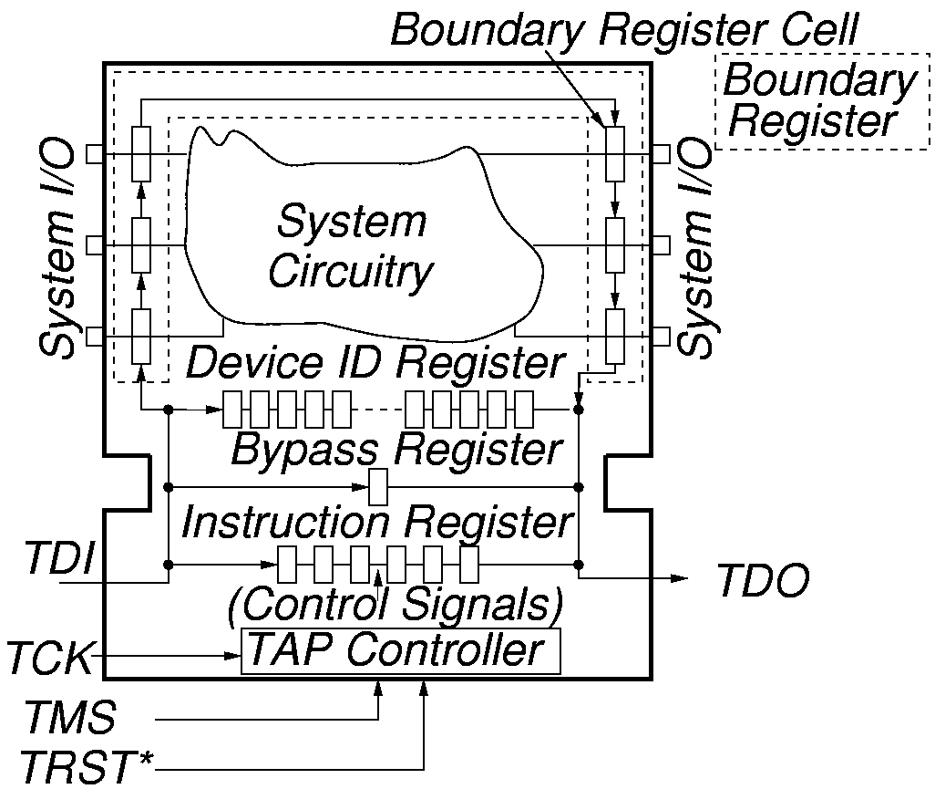
Boundary Scan Test Logic

Slide 65
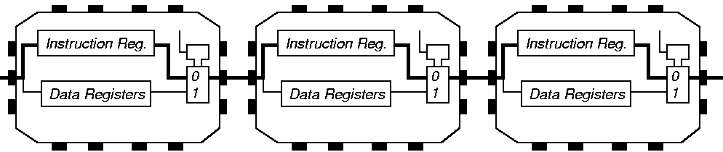
Instruction Register Loading

Slide 66
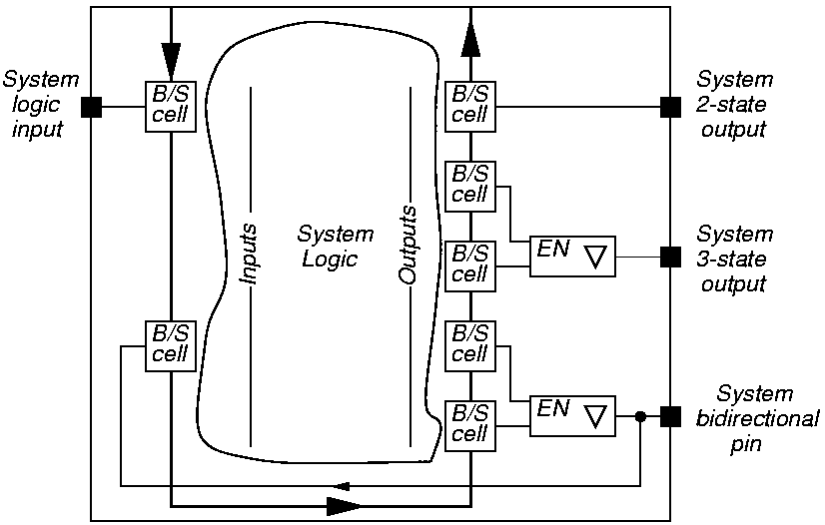
System View of Interconnect

Slide 67
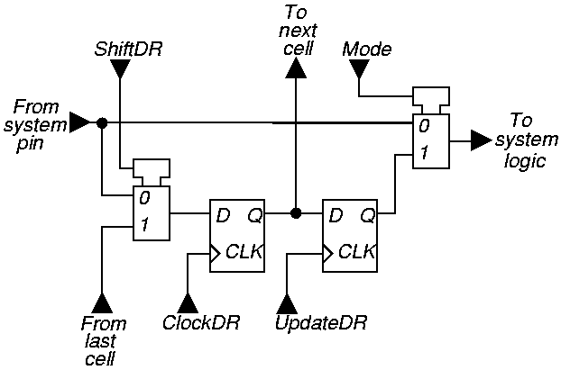
Elementary Boundary Scan Cell

Slide 68
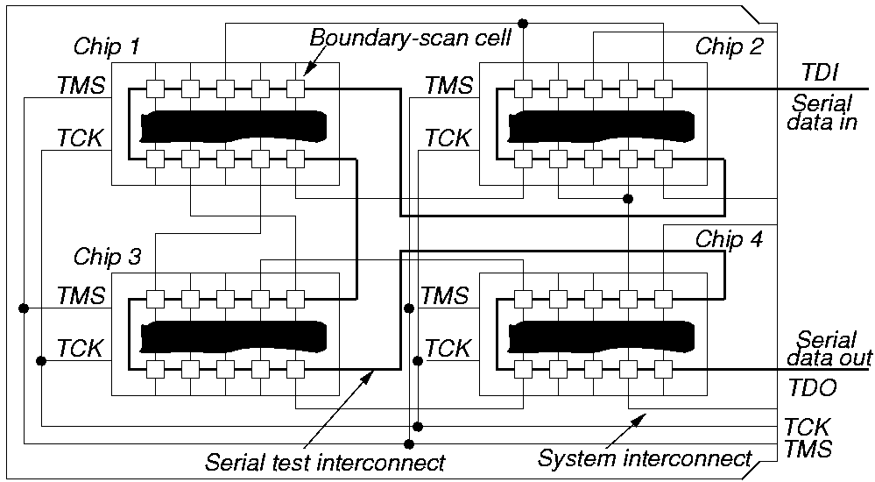
Serial Boundary Scan
PCB or
MCM
Edge connector
Other implementations: 1. Parallel scan, 2. Multiple scans.

Slide 69
Summary
Scan is the most popular DFT technique:
    Rule-based design
    Automated DFT hardware insertion
    Combinational ATPG
Advantages:
    Design automation
    High fault coverage; helpful in diagnosis
    Hierarchical – scan-testable modules are easily combined into large scan-testable systems
    Moderate area (~10%) and speed (~5%) overheads
Disadvantages:
    Large test data volume and long test time
    Basically a slow speed (DC) test

Slide 70
Exercise 5
What is the main advantage of scan method?
Given that the critical path delay of a circuit is 800ps and the scan multiplexer adds a delay of 200ps, determine the performance penalty of scan as percentage reduction in the clock frequency. Assume 20% margin for the clock period and no delay due to the extra fanout of flip-flop outputs.
How will you reduce the test time of a scan circuit by a factor of 10?

Slide 71
Exercise 5 Answers
What is the main advantage of scan method?
Only combinational ATPG (with lower complexity) is used.
Given that the critical path delay of a circuit is 800ps and the scan multiplexer adds a delay of 200ps, determine the performance penalty of scan as percentage reduction in the clock frequency. Assume 20% margin for the clock period and no delay due to the extra fanout of flip-flop outputs.
Clock period of pre-scan circuit = 800+160 = 960ps
Clock period for scan circuit = 800+200+200 = 1200ps
Clock frequency reduction = 100×(1200-960)/1200 = 20%
How will you reduce the test time of a scan circuit by a factor of 10?
Form 10 scan registers, each having 1/10th the length of a single scan register.

Slide 72
BIST
Built-In Self-Test

Slide 73
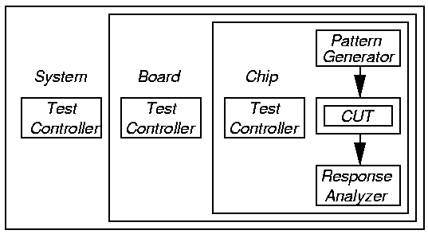
BIST Process
Test controller – Hardware that activates self-test simultaneously on all PCBs
Each board controller activates parallel chip BIST Diagnosis effective only if very high fault coverage

Slide 74
BIST Motivation
Useful for field test and diagnosis (less expensive than a local automatic test equipment)
Software tests for field test and diagnosis:
  Low hardware fault coverage
  Low diagnostic resolution
  Slow to operate
Hardware BIST benefits:
  Lower system test effort
  Improved system maintenance and repair
  Improved component repair
  Better diagnosis

Slide 75
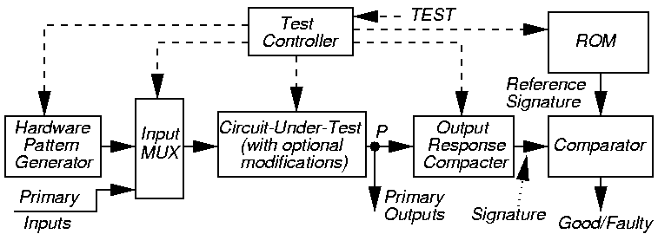
BIST Architecture
Note: BIST cannot test wires and transistors:
  From PI pins to Input MUX
  From POs to output pins

Slide 76
Pattern Generation
Store in ROM – too expensive
Exhaustive
Pseudo-exhaustive
Pseudo-random (LFSR) – Preferred method
Binary counters – use more hardware than LFSR
Modified counters
Test pattern augmentation
  LFSR combined with a few patterns in ROM
  Hardware diffracter – generates pattern cluster in neighborhood of pattern stored in ROM

Slide 77
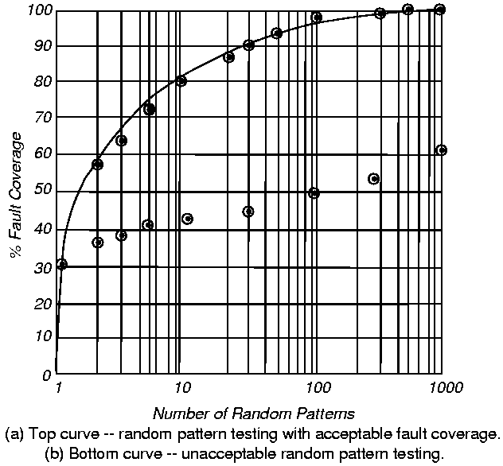
Random Pattern Testing
Bottom:
Random-
Pattern
Resistant
circuit

Slide 78
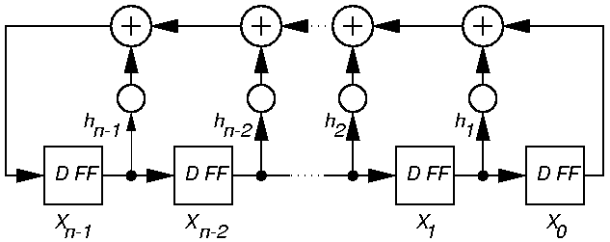
Pseudo-Random Pattern Generation
Standard Linear Feedback Shift Register (LFSR)
  Produces patterns algorithmically – repeatable
  Has most of desirable random # properties
Need not cover all 2^{n} input combinations
Long sequences needed for good fault coverage

Slide 79
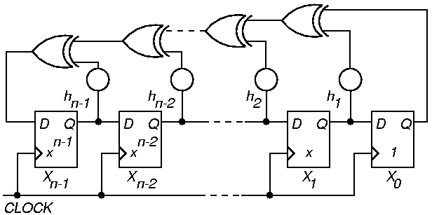
Standard n-Stage LFSR Implementation
Autocorrelation – any shifted sequence same as original in 2^{n-1} – 1 bits, differs in 2^{n-1} bits
If h_{i} = 0, that XOR gate is deleted

Slide 80
LFSR Theory
Cannot initialize to all 0’s – hangs
If X is initial state, progresses through states X, T_{s} X, T_{s}² X, T_{s}³ X, …
Matrix period:
  Smallest k such that T_{s}^{k} = I
  k LFSR cycle length
Described by characteristic polynomial:
  f (x) = |T_{s} – I X |
  = 1 + h₁ x + h₂ x² + … + h_{n-1} x^{n-1} + x^{n}

Slide 81
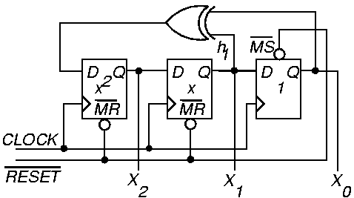
Example External XOR LFSR
Characteristic polynomial f (x) = 1 + x + x³
  (read taps from right to left)

Slide 82
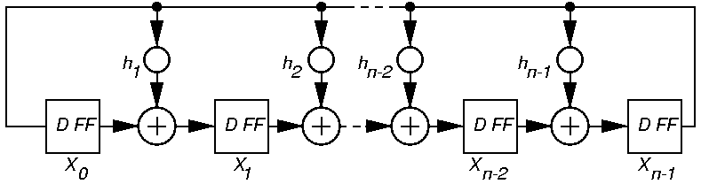
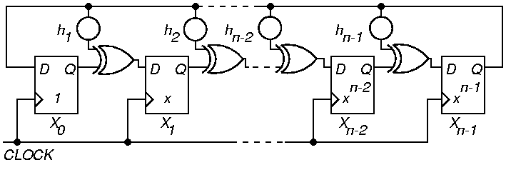
Generic Modular LFSR

Slide 83
Modular Internal XOR LFSR
Described by companion matrix T_{m} = T_{s} ^{T}
Internal XOR LFSR – XOR gates in between D flip-flops
Equivalent to standard External XOR LFSR
  With a different state assignment
  Faster – usually does not matter
  Same amount of hardware
X (t + 1) = T_{m} x X (t)
f (x) = | T_{m} – I X |
= 1 + h₁ x + h₂ x² + … + h_{n-1} x^{n-1} + x^{n}
Right shift – equivalent to multiplying by x, and then dividing by characteristic polynomial and storing the remainder

Slide 84
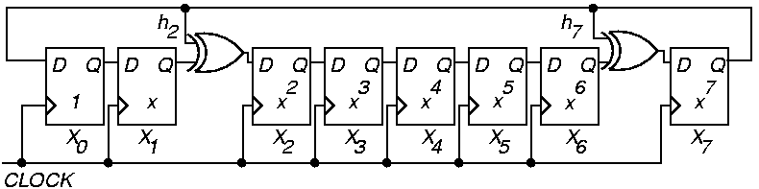
Example Modular LFSR
f (x) = 1 + x² + x⁷ + x⁸
Read LFSR tap coefficients from left to right

Slide 85
Primitive Polynomials
Want LFSR to generate all possible 2^{n} – 1 patterns (except the all-0 pattern)
Conditions for this – must have a primitive polynomial:
  Monic – coefficient of x^{n} term must be 1
  Characteristic polynomial must divide the polynomial 1 – x^{k} for k = 2^{n} – 1, but not for any smaller k value
  See Appendix B of book for tables of primitive polynomials

Slide 86
Weighted Pseudo-Random Pattern Generation
s-a-0
F
1
256
If p (1) at all PIs is 0.5, p_{F} (1) = 0.5⁸ =
Will need enormous # of random patterns to test a stuck-at 0 fault on F – LFSR p (1) = 0.5
  We must not use an ordinary LFSR to test this
IBM – holds patents on weighted pseudo-random pattern generator in ATE
f
1
256
255
256
p_{F} (0) = 1 – =

Slide 87
Weighted Pseudo-Random Pattern Generator
LFSR p (1) = 0.5
Solution: Add programmable weight selection and complement LFSR bits to get p (1)’s other than 0.5
Need 2-3 weight sets for a typical circuit
Weighted pattern generator drastically shortens pattern length for pseudo-random patterns

Slide 88
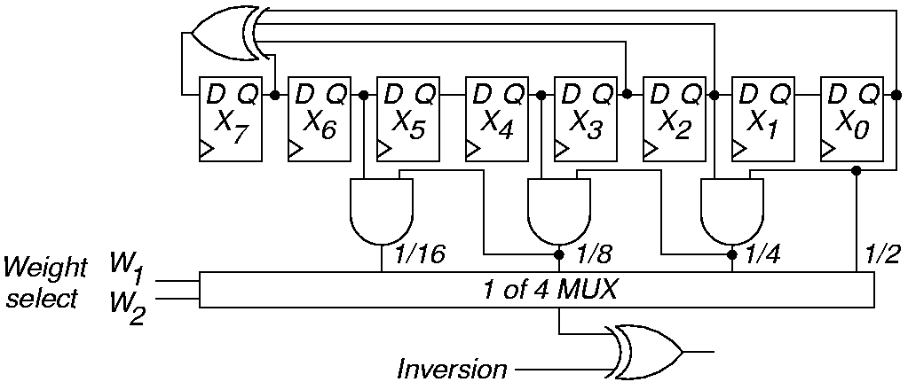
Weighted Pattern Gen.
w₁
0
0
0
0
w₂
0
0
1
1
Inv.
0
1
0
1
p (output)
½
½
¼
3/4
w₁
1
1
1
1
w₂
0
0
1
1
Inv.
0
1
0
1
p (output)
1/8
7/8
1/16
15/16

Slide 89
Test Pattern Augmentation
Secondary ROM – to get LFSR to 100% SAF coverage
  Add a small ROM with missing test patterns
  Add extra circuit mode to Input MUX – shift to ROM patterns after LFSR done
  Important to compact extra test patterns
Use diffracter:
  Generates cluster of patterns in neighborhood of stored ROM pattern
Transform LFSR patterns into new vector set
Put LFSR and transformation hardware in full-scan chain

Slide 90
Response Compaction
Severe amounts of data in CUT response to LFSR patterns – example:
  Generate 5 million random patterns
  CUT has 200 outputs
  Leads to: 5 million x 200 = 1 billion bits response
Uneconomical to store and check all of these responses on chip
Responses must be compacted

Slide 91
Definitions
Aliasing – Due to information loss, signatures of good and some bad machines match
Compaction – Drastically reduce # bits in original circuit response – lose information
Compression – Reduce # bits in original circuit response – no information loss – fully invertible (can get back original response)
Signature analysis – Compact good machine response into good machine signature. Actual signature generated during testing, and compared with good machine signature
Transition Count Response Compaction – Count # transitions from 0 → 1 and 1 → 0 as a signature

Slide 92
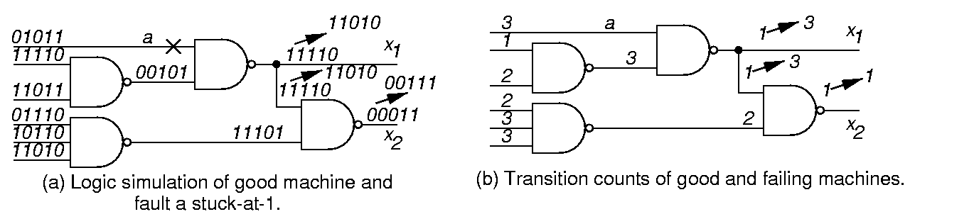
Transition Counting

Slide 93
Transition Counting Details
Transition count:
C (R) = Σ (r_{i} r_{i-1}) for all m primary outputs
To maximize fault coverage:
  Make C (R0) – good machine transition count – as large or as small as possible
m
i = 1

Slide 94
LFSR for Response Compaction
Use cyclic redundancy check code (CRCC) generator (LFSR) for response compacter
Treat data bits from circuit POs to be compacted as a decreasing order coefficient polynomial
CRCC divides the PO polynomial by its characteristic polynomial
  Leaves remainder of division in LFSR
  Must initialize LFSR to seed value (usually 0) before testing
After testing – compare signature in LFSR to known good machine signature
Critical: Must compute good machine signature

Slide 95
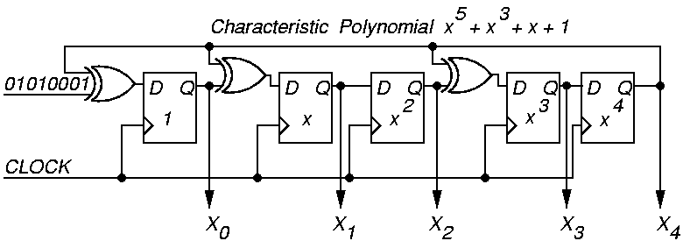
Example Modular LFSR Response Compacter
LFSR seed value is “00000”

Slide 96
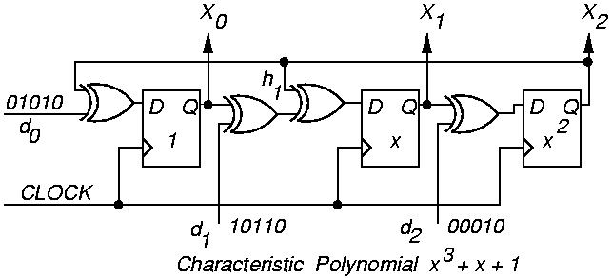
Modular MISR Example
X₀ (t + 1)
X₁ (t + 1)
X₂ (t + 1)
0
1
0
0
0
1
1
1
0
X₀ (t)
X₁ (t)
X₂ (t)
d₀ (t)
d₁ (t)
d₂ (t)
=
+

Slide 97
Aliasing Theorems
Theorem 15.1: Assuming that each circuit PO d_{ij} has probability p of being in error, and that all outputs d_{ij} are independent, in a k-bit MISR, P_{al} = 1/(2^{k}), regardless of initial condition of MISR. Not exactly true – true in practice.
Theorem 15.2: Assuming that each PO d_{ij} has probability p_{j} of being in error, where the p_{j} probabilities are independent, and that all outputs d_{ij} are independent, in a k-bit MISR, P_{al} = 1/(2^{k}), regardless of the initial condition.

Slide 98
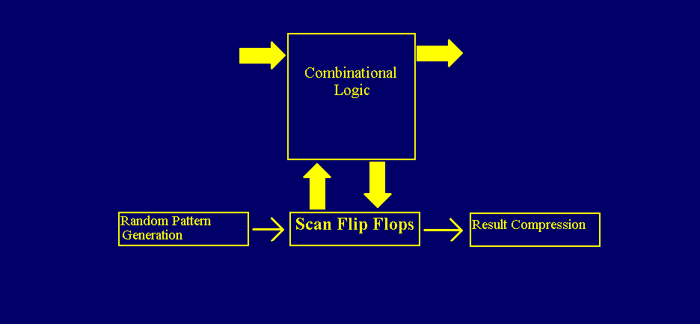
Scan Based Logic BIST

Slide 99
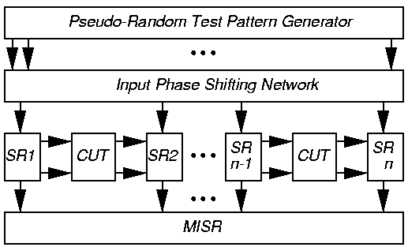
STUMPS Architecture
SR1 … SRn – 25 full-scan chains, each 200 bits
500 chip outputs, need 25 bit MISR (not 5000 bits)

Slide 100
STUMPS
Test procedure:
  Scan in patterns from LFSR into all scan chains (200 clocks)
  Switch to normal functional mode and clock 1 x with system clock
  Scan out chains into MISR (200 clocks) where test results are compacted
    Overlap Steps 1 & 3
Requirements:
  Every system input is driven by a scan chain
  Every system output is caught in a scan chain or drives another chip being sampled

Slide 101
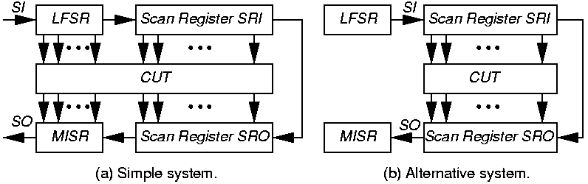
Alternative Test / Scan Systems

Slide 102
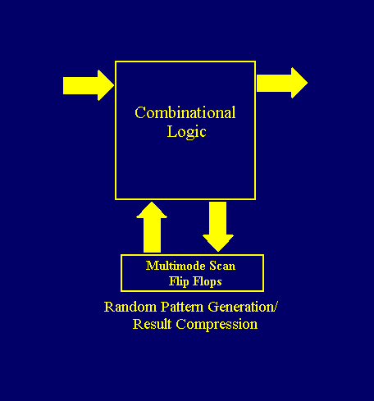
Test-per-Clock BIST
- Combines test generation/results compression in FFs

Slide 103
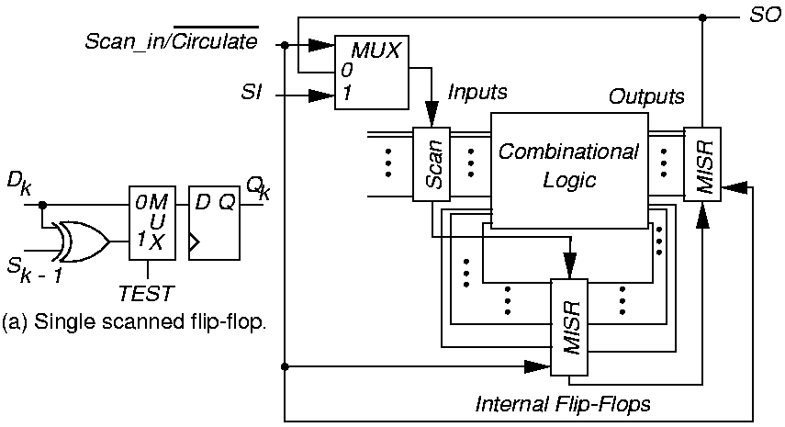
CSTP System
Test per clock

Slide 104
Examples of CSTP Systems
CSTP BIST for 4 ASICs at Lucent Technologies:
  Tested everything on 3 of the 4, except for:
    Input/Output buffers and Input MUX
BIST overheads: logic – 20 %, chip area – 13 %
Stuck-at fault coverage – 92 %

Slide 105
Test Point Insertion
BIST does not detect all faults:
  Test patterns not rich enough to test all faults
Modify circuit after synthesis to improve signal controllability
Observability addition – Route internal signal to extra FF in MISR or XOR into existing FF in MISR

Slide 106
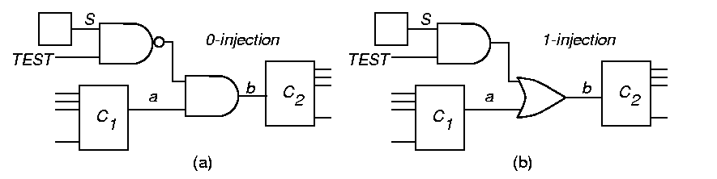
0 and 1 Injection
Force b to 0 when TEST & S are 1
Force b to 1 when TEST & S are 1

Slide 107
Summary
Logic BIST system architecture –
  Advantages:
    Higher fault coverage
    At-speed test
    Less system test, field test & diagnosis cost
  Disadvantage: Higher hardware cost
Architectures: test / clock, test / scan
Needs DFT for initialization, loop-back, and test points, X state elimination

Slide 108
Memory BIST

Slide 109
Definitions
Concurrent BIST – Memory test that happens concurrently with normal system operation
Transparent testing – Memory test that is non-concurrent, but preserves the original memory contents from before testing began

Slide 110
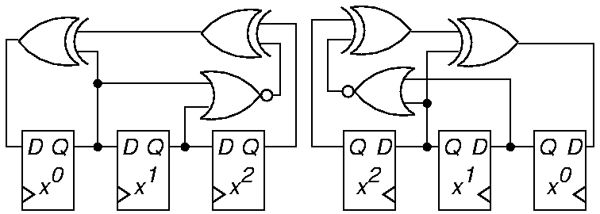
LFSR and Inverse Pattern LFSR
NOR gate forces LFSR into all-0 state
  Get all 2^{n} patterns
Normal LFSR:
  G (x) = x³ + x + 1
Inverse LFSR:
  G (x) = x³ + x² + 1

Slide 111
Up / Down LFSR
Preferred memory BIST pattern generator
  Satisfies March test conditions
0
M
U
X
0
M
U
X
1
1
D
Q
0
M
U
X
D
Q
0
M
U
X
D
Q
X₀
1
X₁
1
X₂
Up/Down

Slide 112
Up / Down LFSR Pattern Sequences
Up Counting
000
100
110
111
011
101
010
001
Down Counting
000
001
010
101
011
111
110
100

Slide 113
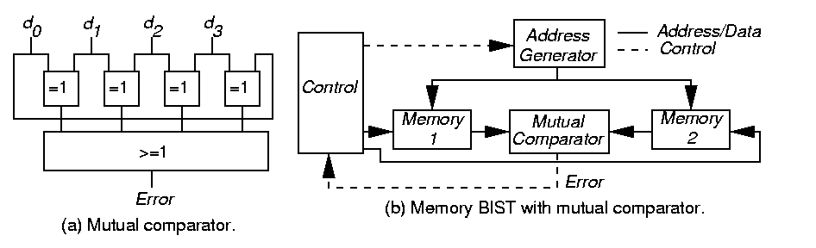
Mutual Comparator
Test 4 or more memory arrays at same time:
  Apply same test commands & addresses to all 4 arrays at same time
  Assess errors when one of the d_{i} (responses) disagrees with the others

Slide 114
Mutual Comparator System
Memory BIST with mutual comparator
Benefit: Need not have good machine response stored or generated

Slide 115
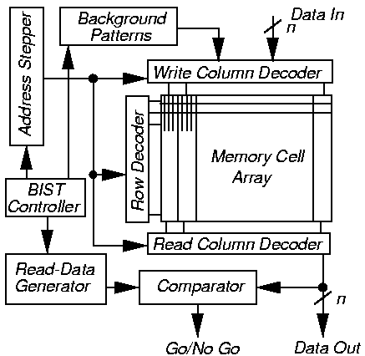
Parallel Memory BIST

Slide 116
Parallel Memory March C
Add MUX to inputs of write drivers:
  Selects normal data input or left neighbor sense amplifier output
    Creates shift register during self-test
Generalize any March test to test n-bit words in array rows
(x)^{n} means repeat x operations n times
Example: March C^{n}
{ (w0)^{n} (r0, w0)^{n}; (r0, w1)^{n} (r1, w1)^{n};
(r1, w0)^{n} (r0, w0)^{n}; (r0, w1)^{n} (r1, w1)^{n};
(r1, w0)^{n} (r0, w0)^{n}; (r0, w0)^{n} (r0, w0)^{n}}

Slide 117
MATS+ RAM BIST
For single-bit word – can generalize to n-bit words
Need Address MUX – switch row decoder from normal input to address stepper (which is the Up/Down LFSR)
# states needed:
  2 x # March elements + 3
Three extra states:
  Start Error Correct
Chip area overhead: 1 to 2 % – widely used

Slide 118
SRAM BIST with MISR
Use MISR to compress memory outputs
Control aliasing by repeating test:
  With different MISR feedback polynomial
  With RAM test patterns in reverse order
March test:
  { (w Address); (r Address); (w Address);
  (r Address); (r Address); (w Address);
  (r Address); (r Address) }
Not proven to detect coupling or address decoder faults

Slide 119
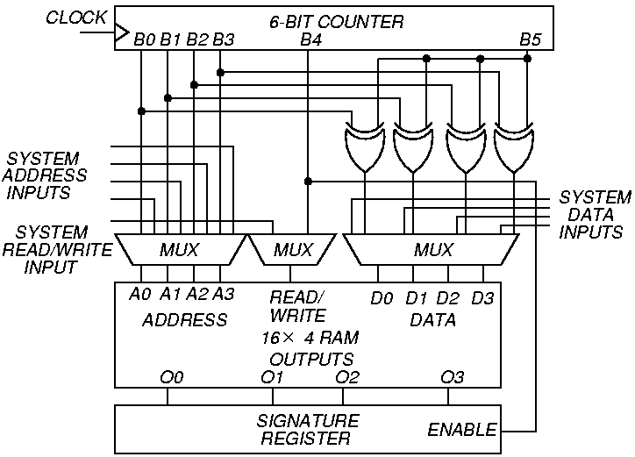
BIST System with MISR

Slide 120
Transparent Testing
Basic rule to preserve memory contents:
  Complement stored data in memory an even # of times
To make any memory test transparent:
  Assume that cell c contains bit v
  Add initial memory read of v to algorithm
  Replace any write x of cell c with write (x v) operation
  If last write on c returns v, add extra read and write operations to complement cell contents

Slide 121
Summary
BIST is gaining acceptance for testability insertion due to:
  Reduced chip area overhead (only 1-3 % chip area for memory BIST)
  Allows partitioning of testing problem
Memory BIST – widely used, < 1 % overhead
Random logic BIST, 13 to 20 % area overheads
  Experimental method has only 6.5 % overhead
  Used by IBM and Lucent Technologies in selected products
Delay fault BIST – experimental stage

Slide 122
Test Compression

Slide 123
Test Compression
BIST has not been widely adopted because it requires significant circuit modification for
Test point insertion to improve coverage
X-state elimination for deterministic response compression
Test Compression methods attempt to achieve a key benefits of BIST – fast test application and low test data volume with deterministic ATPG vectors

Slide 124
Test Compression
Objective
Minimize test application time in scan based environment
Minimize test data volume –the amount of test stimulus and response data stored in the tester memory
Test compression can reduce test costs 10-50X

Slide 125
Test Compression
How it works:
Even after compaction, Test vectors contain many don’t cares
Less that 5% of the bits are “care” bits
The remaining > 95% do not have to be stored in the tester but can be randomly filled by on chip hardware (decoder)
Outputs are compressed in MISRs
Test time savings are obtained by using a large number short parallel scan chains

Slide 126
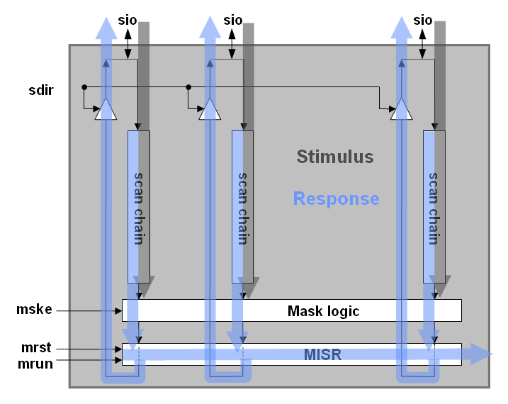
Output Compression
High Level Diagram of IBM OPMISR Scan Architecture
05/18/01 V4.3
Notes:
The slide guide is available in the following file:
slidesV4.3.ppt: PowerPoint 2000 format. Viewable also
with PowerPoint ’97.

Slide 127
Illinois Scan
Each Scan input feeds many
parallel internal scan chains
Thus one bit from the tester can create many bits on-chip for the scan test vector
Problem only if a test needs the bits in the same position in two connected parallel chains to be different – rare occurrence
ATPG performed assuming this scan structural limitation can limit such conflicts
For a few test hard cases, the chains can be serially configured

Slide 128
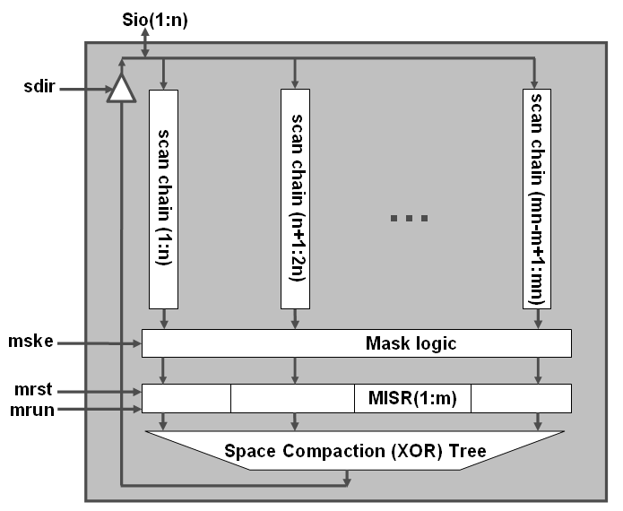
IBM OPMISR+
High Level Diagram of an OPMISR + Scans Architecture (2002)
05/18/01 V4.3
Notes:
The slide guide is available in the following file:
slidesV4.3.ppt: PowerPoint 2000 format. Viewable also
with PowerPoint ’97.

Slide 129
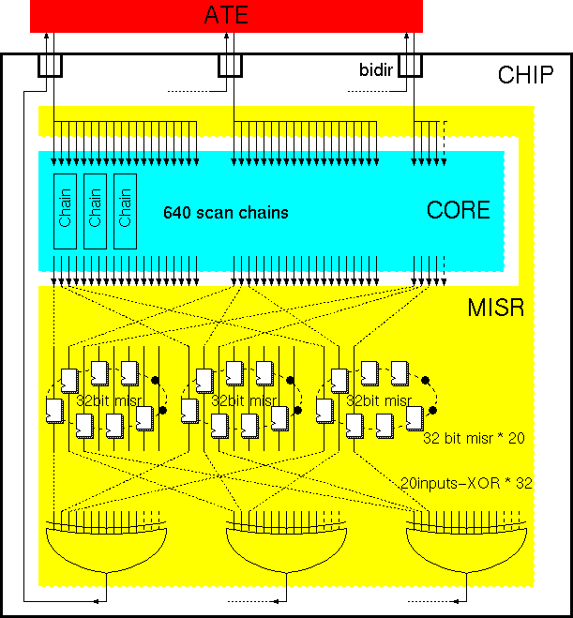
Example
Example Implementation of OPMISR+
05/18/01 V4.3
Notes:
The slide guide is available in the following file:
slidesV4.3.ppt: PowerPoint 2000 format. Viewable also
with PowerPoint ’97.

Slide 130
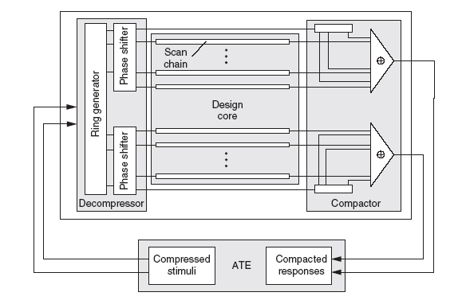
Embedded Deterministic Test (Mentor Graphics)

Slide 131
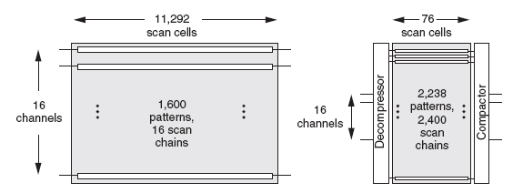
Reduced Test Application Time
Test time saving from many shorter scan chains
Potentially >100X in this example

Slide 132
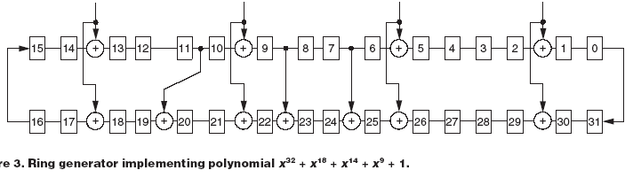
EDT Ring Generator

Slide 133
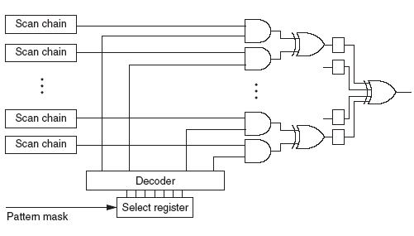
EDT Output Compression

Slide 134
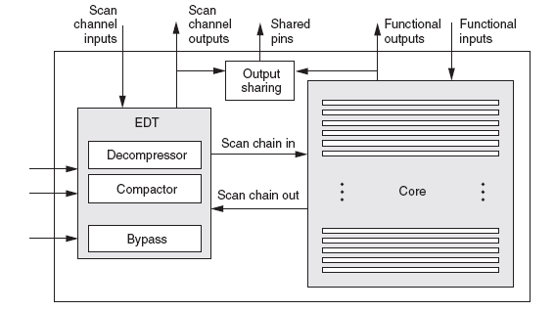
EDT For SOC Core

Slide 135
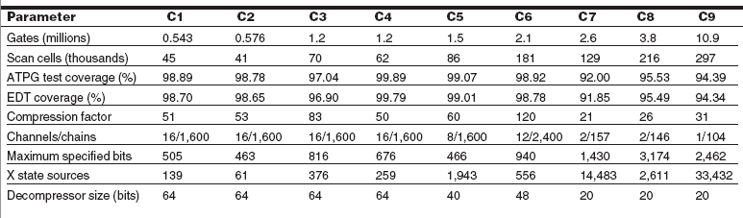
EDT Results

